Slide 1

from 15-Aug-2019 to 01-January 2023
Shopee Brazil Customers
Sales Data Analysis
(SCTP) Associate Data Analyst: Capstone Project – P4
Emma

Slide 2
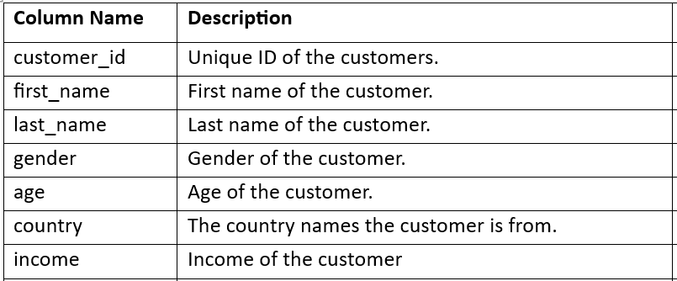
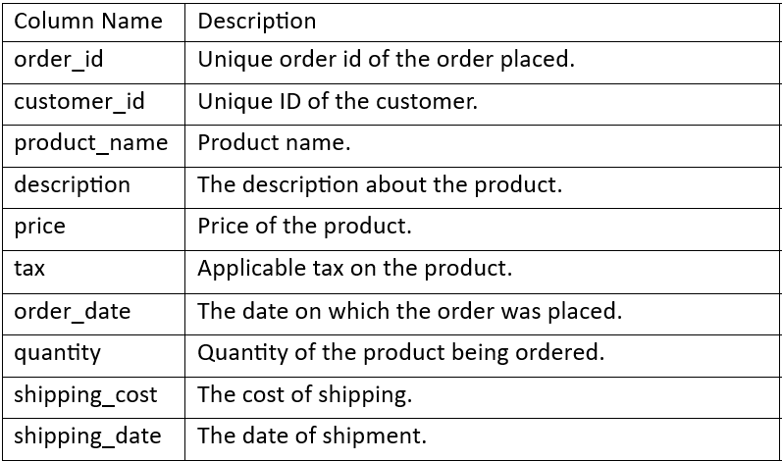
Data Pipeline
The Dataset includes Two main parts
Customer Data and Purchase Data provided by
Shopee Brazil from the Year 2019 to 2023.
Customer Dataset
Purchase Dataset
Dataset Size & Format | 47.csv
Customer Dataset (in CSV format)
Purchase Dataset (in CSV format)
These datasets are imported into Power Query Editor within
Power BI for further cleaning and transformation.
Dataset Size & Format | 6,814.csv

Slide 3

Data Cleaning & Process
Using Power Query Editor
Change Data Types:
Converted the Customer Income field from Whole Number to Fixed Decimal Number.
Adjusted the Purchase Price, Discount, Tax, and Shipping Cost columns from Decimal Number to Fixed Decimal Number.
Add New Column Names
Delivery Lead Time
to count/track the number of days on delivery of product from Seller to Buyer.
Delivery Lead Time Rate (Range)
to track the delivery lead time rating
Days from 0 to 3 is “Excellent”
Days from 4 to 5 is “Good”
Days 6 onward is “Terrible”
The data has been successfully cleaned, transformed, and loaded into Power BI for further analysis and visualization.

Slide 4

Introduction
My Data
Analysis of Shopee Brazil’s sales data, focusing on customer sales trends.
Customer Persona (Power BI Slide)
Demographic by Age
Demographic by Income
Sales Revenue
Insights Behavior (Power BI Slide)
Sales Income by Country
Sales Income by Age
Other Insights (Power BI Slide)
Delivery Lead Time
New Idea (Power Point Slide)
Improvement Plan
Portuguese translates to English it means “Discover”, “Shopee” & “Brazil”

Slide 5
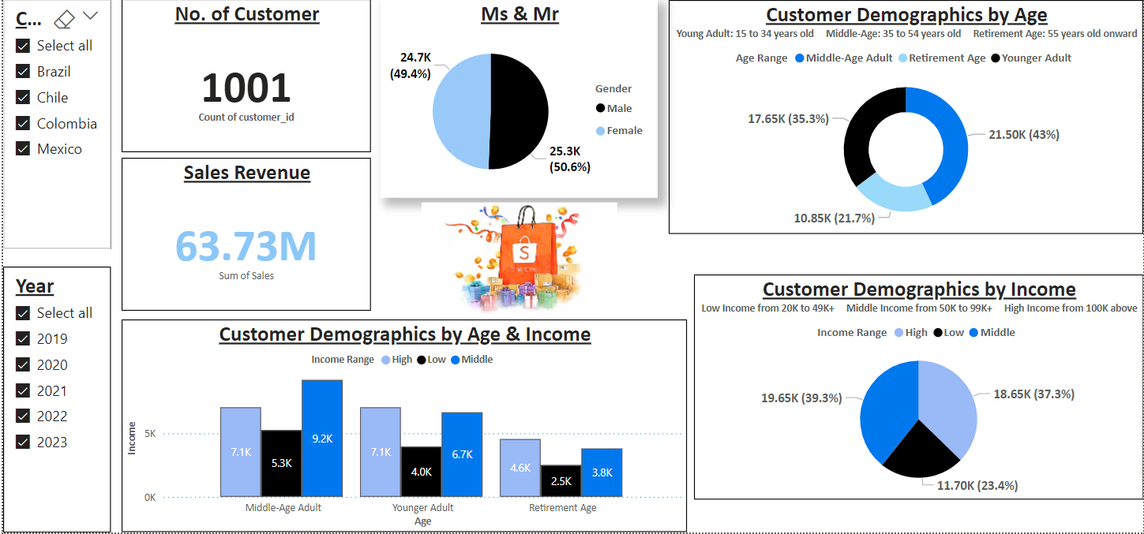
Dashboard

Slide 6
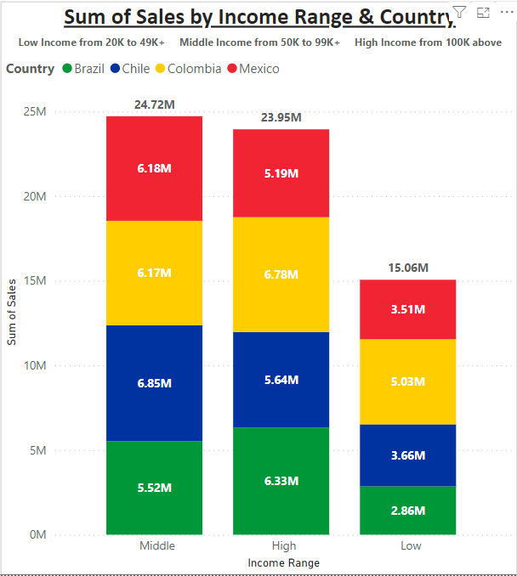





Total Sales by Income Range & Country
The Stacker Column Chart displays the sum of sales by income range (Low, Middle, High) across four countries: Brazil, Chile, Colombia, and Mexico.
Insights:
Middle Income Range has the highest sales, with Chile and Mexico leading.
Colombia consistently ranks high across all income ranges, with a total of 17.98M.
Brazil consistently has lower sales across all ranges, totaling 14.71M.
Total Sales Ranking by Country:
1st Colombia: 17.98M
2nd Chile: 16.15M
3rd Mexico: 14.88M
4th Brazil: 14.71M

Slide 7
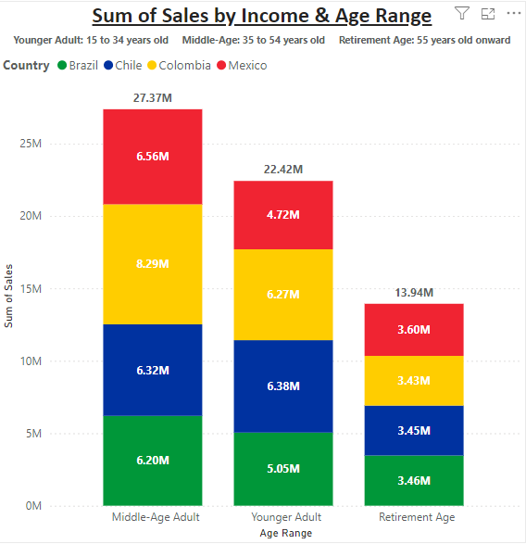
Total Sales by Age Range & Country
4th Brazil: 14.71M
The Stacker Column chart shows total sales by age group (Younger Adult, Middle Age Adult, Retirement Age) across four countries: Brazil, Chile, Colombia, and Mexico.
Insights:
Middle Income Range has the highest sales, with Mexico and Colombia leading.
Colombia consistently ranks high across all income ranges, with a total of 17.99M.
Total Sales by Country:
1st Colombia: 17.99M
2nd Chile: 16.15M
3rd Mexico: 14.88M
4th Brazil: 14.71M
3rd Mexico: 14.88M
1st Colombia: 17.99M
2nd Chile: 16.15M

Slide 8
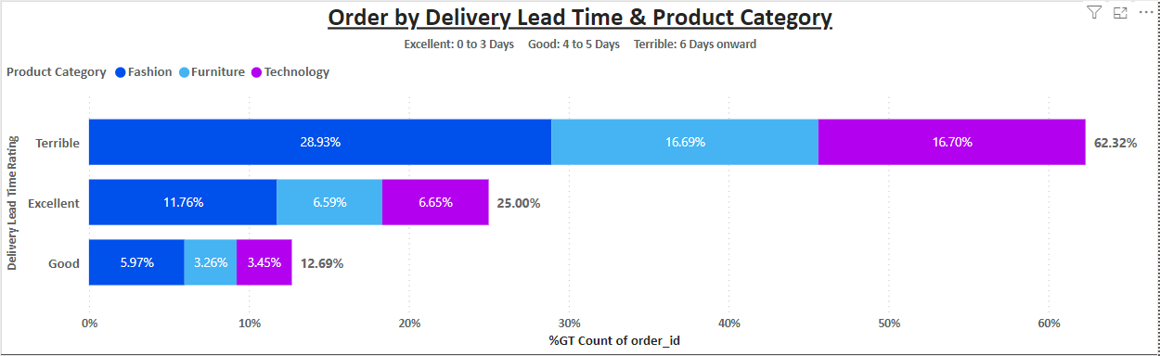
Order Delivery Lead Time & Product Category
The Stacked Bar chart shows the delivery lead time performance categorized by Product Category (Furniture, Fashion, and Technology) across three ratings:
Terrible Delivery
(6 days or more):
62.32% of total orders.
Furniture leads with the worst performance at 16.70%.
Excellent Delivery
(0 to 3 days):
25% of total orders.
Fashion leads in this category with 11.76%.
Good Delivery
(4 to 5 days):
12.69% of total orders.
Fashion also leads here at 5.97%.
Insights:
Shopee should focus on improving delivery times, especially for “Terrible Delivery” to boost customer satisfaction and increase sales revenue.

Slide 9

Conclusion
&
Improvement Plan
Younger Adults Income (35.3%%) and Middle-Income customers (39.3%) are key segments for Shopee. However, 62.32% of orders experienced Terrible delivery times, particularly in the Furniture category (28.93%).
To improve, Shopee should:
Focus on Younger Adults with affordable products.
Target premium offerings to Middle- and High-Income customers.
Improve delivery performance, especially for Furniture products.
Continuous monitoring of customer behavior and delivery trends will help Shopee stay competitive.

Slide 10

Challenges Faced And Problem Solving
Challenges: During the analysis, Shopee Brazil Excel Customer and Purchase Data.
Missing Data:
Customer Age Range and Income Range
Purchase Delivery Lead Time, Delivery Lead Time Range, Sales Amount, and Product Categories.
Time Gaps: 15 Aug 2019 to 01 Jan 2023
Large Dataset: Managing large data for a beginner
Problem-Solving
Date Fixes:
Used Power Query Editor to handle missing data
Created new columns in Power BI for better analysis
Data Classification:
Age Range:
15 to 34: “Younger Adults”
35-54: “Middle-Age Adults”
55+: “Retirement Age”
Income Range:
20,000 to 49,999: “Low”
50,000 to 99,999: “Middle”
100,000+: “High”
Improved analysis of customer behavior and sales trends.

Slide 11

Reflections
The primary challenge was handling missing data in customer dataset. Through the process of data cleaning, I learned how crucial complete and accurate data is for generating reliable insights. Working with Power BI also enhanced my understanding of data visualization techniques, helping to present complex data in a clear and actionable way.
What I would do differently?
Better understanding of customer behavior trends.
Improved data cleaning and analysis techniques.
Increased confidence in using tools like Power BI.

Slide 12
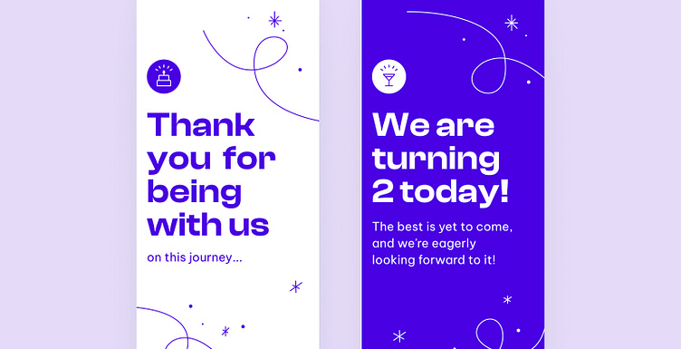
with Shopee Latin America

Slide 13

Q & A

